Slide 1
Term weighting and Vector space retrieval

Slide 2
Vector Space Model
It represents documents and queries as vectors of features representing terms
features are assigned some numerical value that is usually some function of frequency of terms
Ranking algorithm compute similarity between document and query vectors to yield a retrieval score to each document.

Slide 3
Documents as vectors
Each doc d is viewed as a vector of tf×idf values, one component for each term
So we have a vector space
  terms are axes
  docs live in this space

Slide 4
Vector Space Model
Given a finite set of n documents:
D = {d₁, d₂, ...,d_{j},...,d_{n}}
and a finite set of m terms:
T = {t₁, t₂, ...,t_{i},...,t_{m}}
Each document will be represented by a column vector of weights as follows:
(w_{1j}, w_{2j}, w_{3j}, . . w_{ij} , … w_{mj})^{t}
w_{ij} is the weight of term t_{i} in document d_{j}.

Slide 5
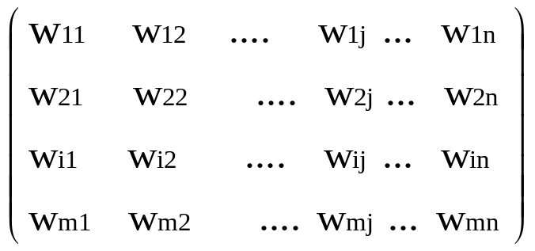
Vector Space Model
The document collection as a whole will be represented by an m x n term–document matrix as:

Slide 6
Example: Vector Space Model
D1 = Information retrieval is concerned with the organization, storage, retrieval and evaluation of information relevant to user’s query.
D2 = A user having an information need formulates a request in the form of query written in natural language.
D3 = The retrieval system responds by retrieving document that seems relevant to the query.

Slide 7
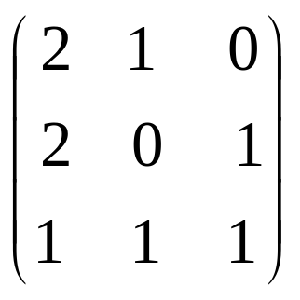
Example: Vector Space Model
Let the weights be assigned based on the frequency of the term within the document.
The term – document matrix is:

Slide 8
Vector Space Model
Raw term frequency approach gives too much importance to the absolute values of various coordinates of each document

Slide 9
Consider two document vectors
(2, 2, 1)^{t}
(4, 4, 2)^{t}
The documents look similar except the differences in magnitude of term weights.

Slide 10
Normalizing term weights
To reduce the importance of the length of document vectors we normalize document vectors
Normalization changes all the vectors to a standard length.
We can convert document vectors to unit length by dividing each dimension by the overall length of the vector.

Slide 11
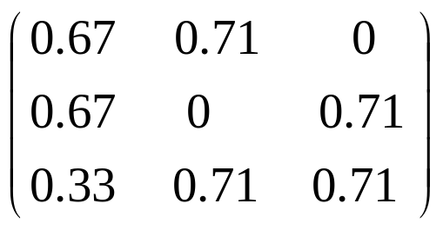
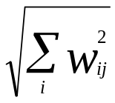
Normalizing the term-document matrix:
We get
Elements of each column are divided by the length of the column vector ( )

Slide 12
Term weighting
Postulates
1. The more a document contains a given word the more that document is about a concept represented by that word.
2. The less a term occurs in particular document in a collection, the more discriminating that term is.

Slide 13
Term weighting
The first factor simply means that terms that occur more frequently represent its meaning more strongly than those occurring less frequently
The second factor considers term distribution across the document collection.
Notes:
Terms occurring in few documents are useful for distinguishing those documents from rest of the collection. Similarly, terms that occur more frequently across the entire collection are less helpful in discriminating among documents. This requires a measure that favors terms appearing in fewer documents.

Slide 14
Term weighting
→ a measure that favors terms appearing in fewer documents is required
The fraction n/n_{i}, exactly gives this measure
where,
n is the total number of the document in the collection
& n_{i} is the number of the document in which term i occurs

Slide 15

Term weighting
As the number of documents in any collection is usually large, log of this measure is usually taken, resulting in the following form of inverse document frequency (idf) term weight:

Slide 16

Tf-idf weighting scheme
tf - document specific statistic
idf - is global statistic and attempts to include distribution of term across document collection.

Slide 17
Tf-idf weighting scheme
The term frequency (tf) component is document specific statistic that measures the importance of term within the document
The inverse document frequency (idf) is global statistic and attempts to include distribution of term across document collection.

Slide 18

Tf-idf weighting scheme
Example: Computing tf-idf weight( total docs=100)

Slide 19

Normalizing tf and idf factors
by dividing the term frequency by the frequency of the most frequent term in the document
idf can be normalized by dividing it by the logarithm of the collection size (n).

Slide 20
Term weighting schemes
A third factor that may affect weighting function is the document length
the weighting schemes can thus be characterized by the following three factors:
1. Within-document frequency or term frequency
2. Collection frequency or inverse document frequency
3. Document length

Slide 21
term weighting scheme can be represented by a triple ABC
A - tf component
B - idf component
& C - length normalization component.

Slide 22
Different combinations of options can be used to represent document and query vectors.
The retrieval model themselves can be represented by a pair of triples like nnn.nnn (doc = “nnn”, query = “nnn”)

Slide 23
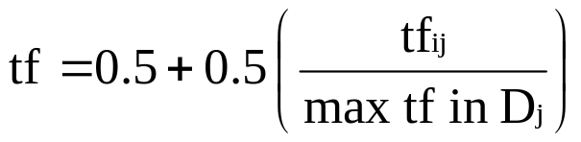
Options for the three weighting factors
Term frequency within document (A)
n Raw term frequency tf = tfij
b tf = 0 or 1 (binary weight)
a Augmented term frequency
l tf = ln(tfij) + 1.0 Logarithmic term frequency
Inverse Document frequency (B)
n wt = tf no conversion
t Multiply tf with idf

Slide 24
Options for the three weighting factors
Document length (C)
n w_{ij} = wt (no conversion)
c w_{ij} is obtained by dividing each wt by sqrt(sum of(wts squared))

Slide 25
Indexing Algorithm
Step 1. Tokenization: This extracts individual terms (words) in the document, converts all the words in the lower case and removes punctuation marks. The output of the first stage is a representation of the document as a stream of terms.
Step 2. Stop word elimination: Removes words that appear more frequently in the document collection.
Step 3. Stemming: reduce remaining terms to their linguistic root, to get index terms.
Step 4. Term weighting: Assigns weights to term according to their importance in the document, in the collection or some combination of both.

Slide 26

Example: Document Representation
Stemmed terms Document 1 Document 2 Document 3
inform | 0 | 0 | 1
intellig | 0 | 0 | 1
model | 1 | 1 | 0
probabilist | 0 | 1 | 0
retriev | 0 | 1 | 1
space | 1 | 0 | 0
technique | 0 | 0 | 1
vector | 1 | 0 | 0

Slide 27
Why turn docs into vectors?
First application: Query-by-example
  Given a doc d, find others “like” it.
Now that d is a vector, find vectors (docs) “near” it.

Slide 28
Intuition
t₃
d₂
d₃
d₁
θ
φ
t₁
d₅
t₂
d₄
Postulate: Documents that are “close together”
in the vector space talk about the same things.

Slide 29
Desiderata for proximity
If d₁ is near d₂, then d₂ is near d₁.
If d₁ near d₂, and d₂ near d₃, then d₁ is not far from d₃.
No doc is closer to d than d itself.

Slide 30
First cut
Idea: Distance between d₁ and d₂ is the length of the vector |d₁ – d₂|.
  Euclidean distance
Why is this not a great idea?
  Short documents would be more similar to each other by virtue of length, not topic
However, we can implicitly normalize by looking at angles instead

Slide 31
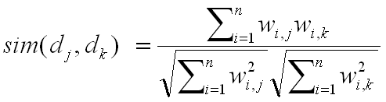
Cosine similarity
Distance between vectors d₁ and d₂ captured by the cosine of the angle x between them.
Note – this is similarity, not distance
t ₃
d ₂
d ₁
θ
t ₁
t ₂

Slide 32
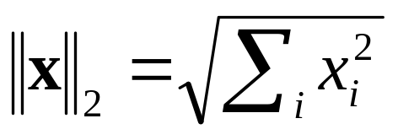
Cosine similarity
A vector can be normalized (given a length of 1) by dividing each of its components by its length
This maps vectors onto the unit sphere:
Then,
Longer documents don’t get more weight

Slide 33
Cosine similarity
Cosine of angle between two vectors
The denominator involves the lengths of the vectors.
Normalization

Slide 34
Normalized vectors
For normalized vectors, the cosine is simply the dot product:

Slide 35
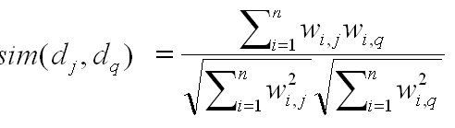
Queries in the vector space model
Central idea: the query as a vector:
We regard the query as short document
We return the documents ranked by the closeness of their vectors to the query, also represented as a vector.
Note that d_{q} is very sparse!

Slide 36
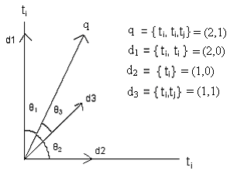
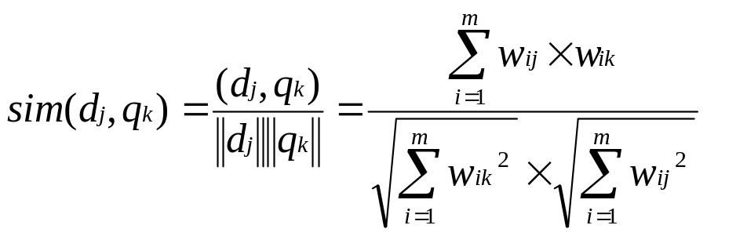
Similarity Measures
cosine similarity

Slide 37
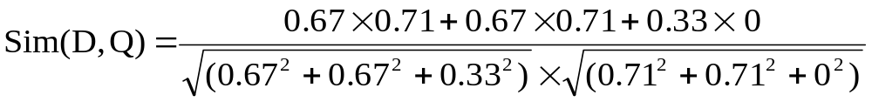
Let
D = (0.67 0.67 0.33)^{t}
and Q = (0.71 0.71 0)^{t}
then the cosine similarity between D and Q will be :

Slide 38
Summary: What’s the point of using vector spaces?
A well-formed algebraic space for retrieval
Key: A user’s query can be viewed as a (very) short document.
Query becomes a vector in the same space as the docs.
Can measure each doc’s proximity to it.
Natural measure of scores/ranking – no longer Boolean.
  Queries are expressed as bags of words

Slide 39
Interaction: vectors and phrases
Scoring phrases doesn’t fit naturally into the vector space world:
  “tangerine trees” “marmalade skies”
  Positional indexes don’t calculate or store tf.idf information for “tangerine trees”
Biword indexes (extend the idea to vector space)
  For these, we can pre-compute tf.idf.
We can use a positional index to boost or ensure phrase occurrence

Slide 40
Vectors and wild cards
How about the query tan* marm*?
  Can we view this as a bag of words?
  Thought: expand each wild-card into the matching set of dictionary terms.
Danger – unlike the Boolean case, we now have tfs and idfs to deal with.

Slide 41
Vector spaces and other operators
Vector space queries are apt for no-syntax, bag-of-words queries (i.e. free text)
  Clean metaphor for similar-document queries
Not a good combination with Boolean, wild-card, positional query operators

Slide 42
Query language vs. scoring
May allow user a certain query language, say
  Free text basic queries
  Phrase, wildcard etc. in Advanced Queries.
For scoring (oblivious to user) may use all of the above, e.g. for a free text query
  Highest-ranked hits have query as a phrase
  Next, docs that have all query terms near each other
  Then, docs that have some query terms, or all of them spread out, with tf x idf weights for scoring

Slide 43
Exercises
How would you augment the inverted index built in lectures 1–3 to support cosine ranking computations?
Walk through the steps of serving a query.
The math of the vector space model is quite straightforward, but being able to do cosine ranking efficiently at runtime is nontrivial

Slide 44
Efficient cosine ranking
Find the k docs in the corpus “nearest” to the query ⇒ k largest query-doc cosines.
Efficient ranking:
  Computing a single cosine efficiently.
  Choosing the k largest cosine values efficiently.
    Can we do this without computing all n cosines?
      n = number of documents in collection

Slide 45
Limiting the accumulators:
Frequency/impact ordered postings
Idea: we only want to have accumulators for documents for which wf_{t,d} is high enough
We sort postings lists by this quantity
We retrieve terms by idf, and then retrieve only one block of the postings list for each term
We continue to process more blocks of postings until we have enough accumulators
  Can continue one that ended with highest wf_{t,d}
  The number of accumulators is bounded
Anh et al. 2001

Slide 46
Cluster pruning: preprocessing
Pick √n docs at random: call these leaders
For each other doc, pre-compute nearest leader
  Docs attached to a leader: its followers;
  Likely: each leader has ~ √n followers.

Slide 47
Cluster pruning: query processing
Process a query as follows:
  Given query Q, find its nearest leader L.
  Seek k nearest docs from among L’s followers.

Slide 48
Visualization
Query
Leader
Follower

Slide 49
Why use random sampling
Fast
Leaders reflect data distribution

Slide 50
General variants
Have each follower attached to a=3 (say) nearest leaders.
From query, find b=4 (say) nearest leaders and their followers.
Can recur on leader/follower construction.

Slide 51
Dimensionality reduction
What if we could take our vectors and “pack” them into fewer dimensions (say 50,000→100) while preserving distances?
(Well, almost.)
  Speeds up cosine computations.
Two methods:
  Random projection.
  “Latent semantic indexing”.

Slide 52
Random projection onto k<<m axes
Choose a random direction x₁ in the vector space.
For i = 2 to k,
  Choose a random direction x_{i} that is orthogonal to x₁, x₂, … x_{i–1}.
Project each document vector into the subspace spanned by {x₁, x₂, …, x_{k}}.

Slide 53
E.g., from 3 to 2 dimensions
t ₃
d₂
x₂
x₂
d₂
d₁
d₁
t ₁
x₁
x₁
t ₂
x₁ is a random direction in (t₁,t₂,t₃) space.
x₂ is chosen randomly but orthogonal to x₁.
Dot product of x₁ and x₂ is zero.

Slide 54
Guarantee
With high probability, relative distances are (approximately) preserved by projection.
Pointer to precise theorem in Resources.

Slide 55
Computing the random projection
Projecting n vectors from m dimensions down to k dimensions:
  Start with m × n matrix of terms × docs, A.
  Find random k × m orthogonal projection matrix R.
  Compute matrix product W = R × A.
j^{th} column of W is the vector corresponding to doc j, but now in k << m dimensions.

Slide 56
Cost of computation
Why?
This takes a total of kmn multiplications.
Expensive

Slide 57
Latent semantic indexing (LSI)
Another technique for dimension reduction
Random projection was data-independent
LSI on the other hand is data-dependent
  Eliminate redundant axes
  Pull together “related” axes – hopefully
    car and automobile

